Slide 1




FSelector: Variable Selection Using Visual Features
Presenter: Tommy Dang
Assistant Professor, Texas Tech University

Slide 2
Outline
System overview
Background and related work
Visualization
Demo
Future work

Slide 3
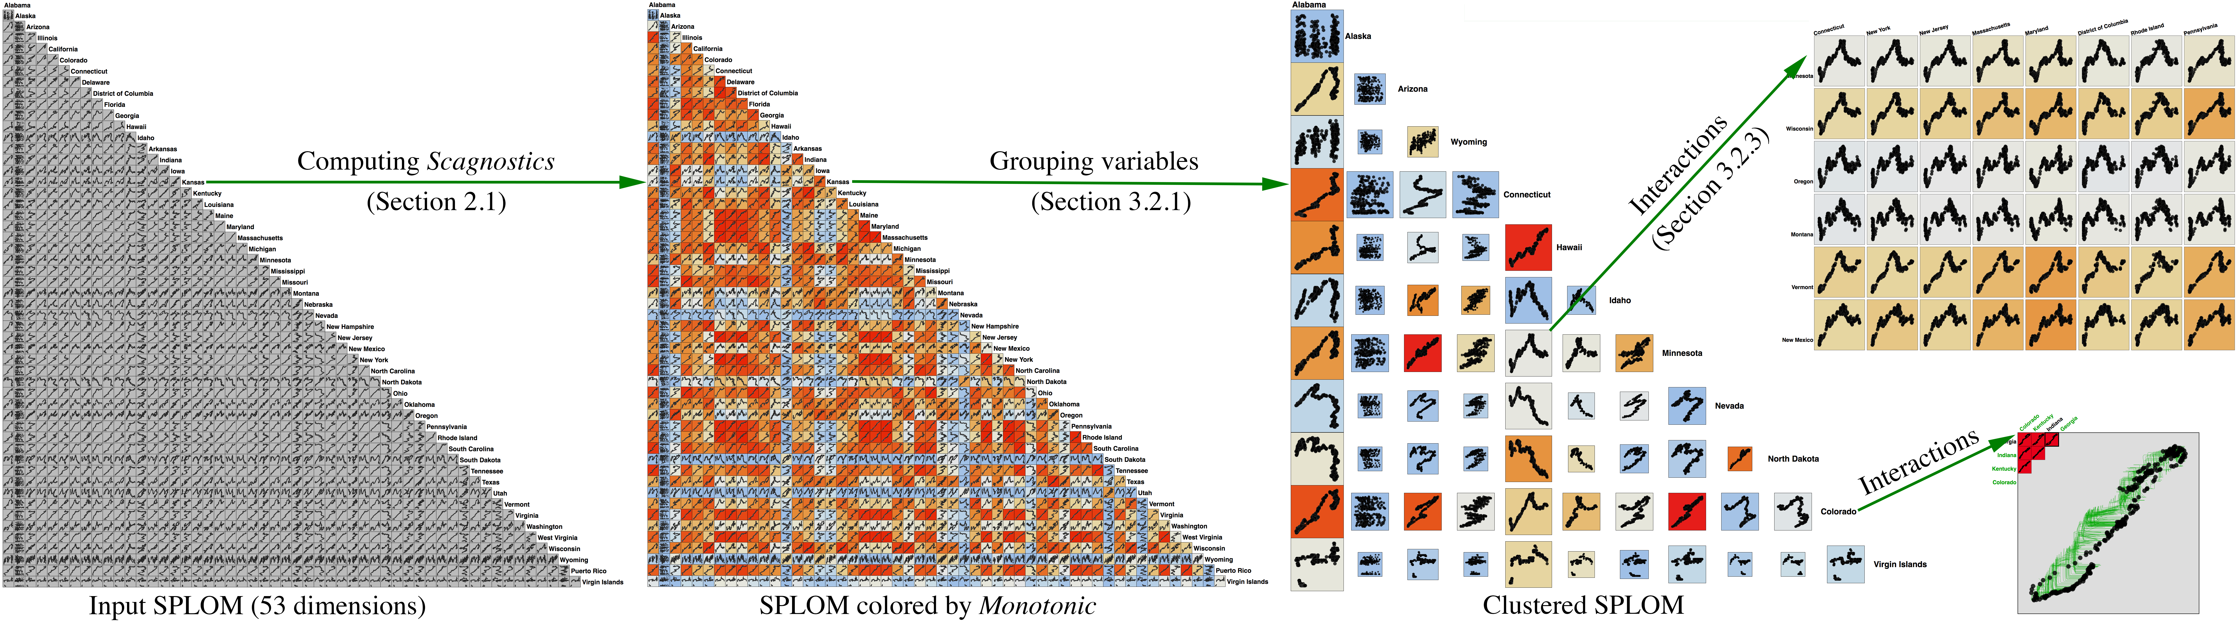
Introduction
Overview

Slide 4
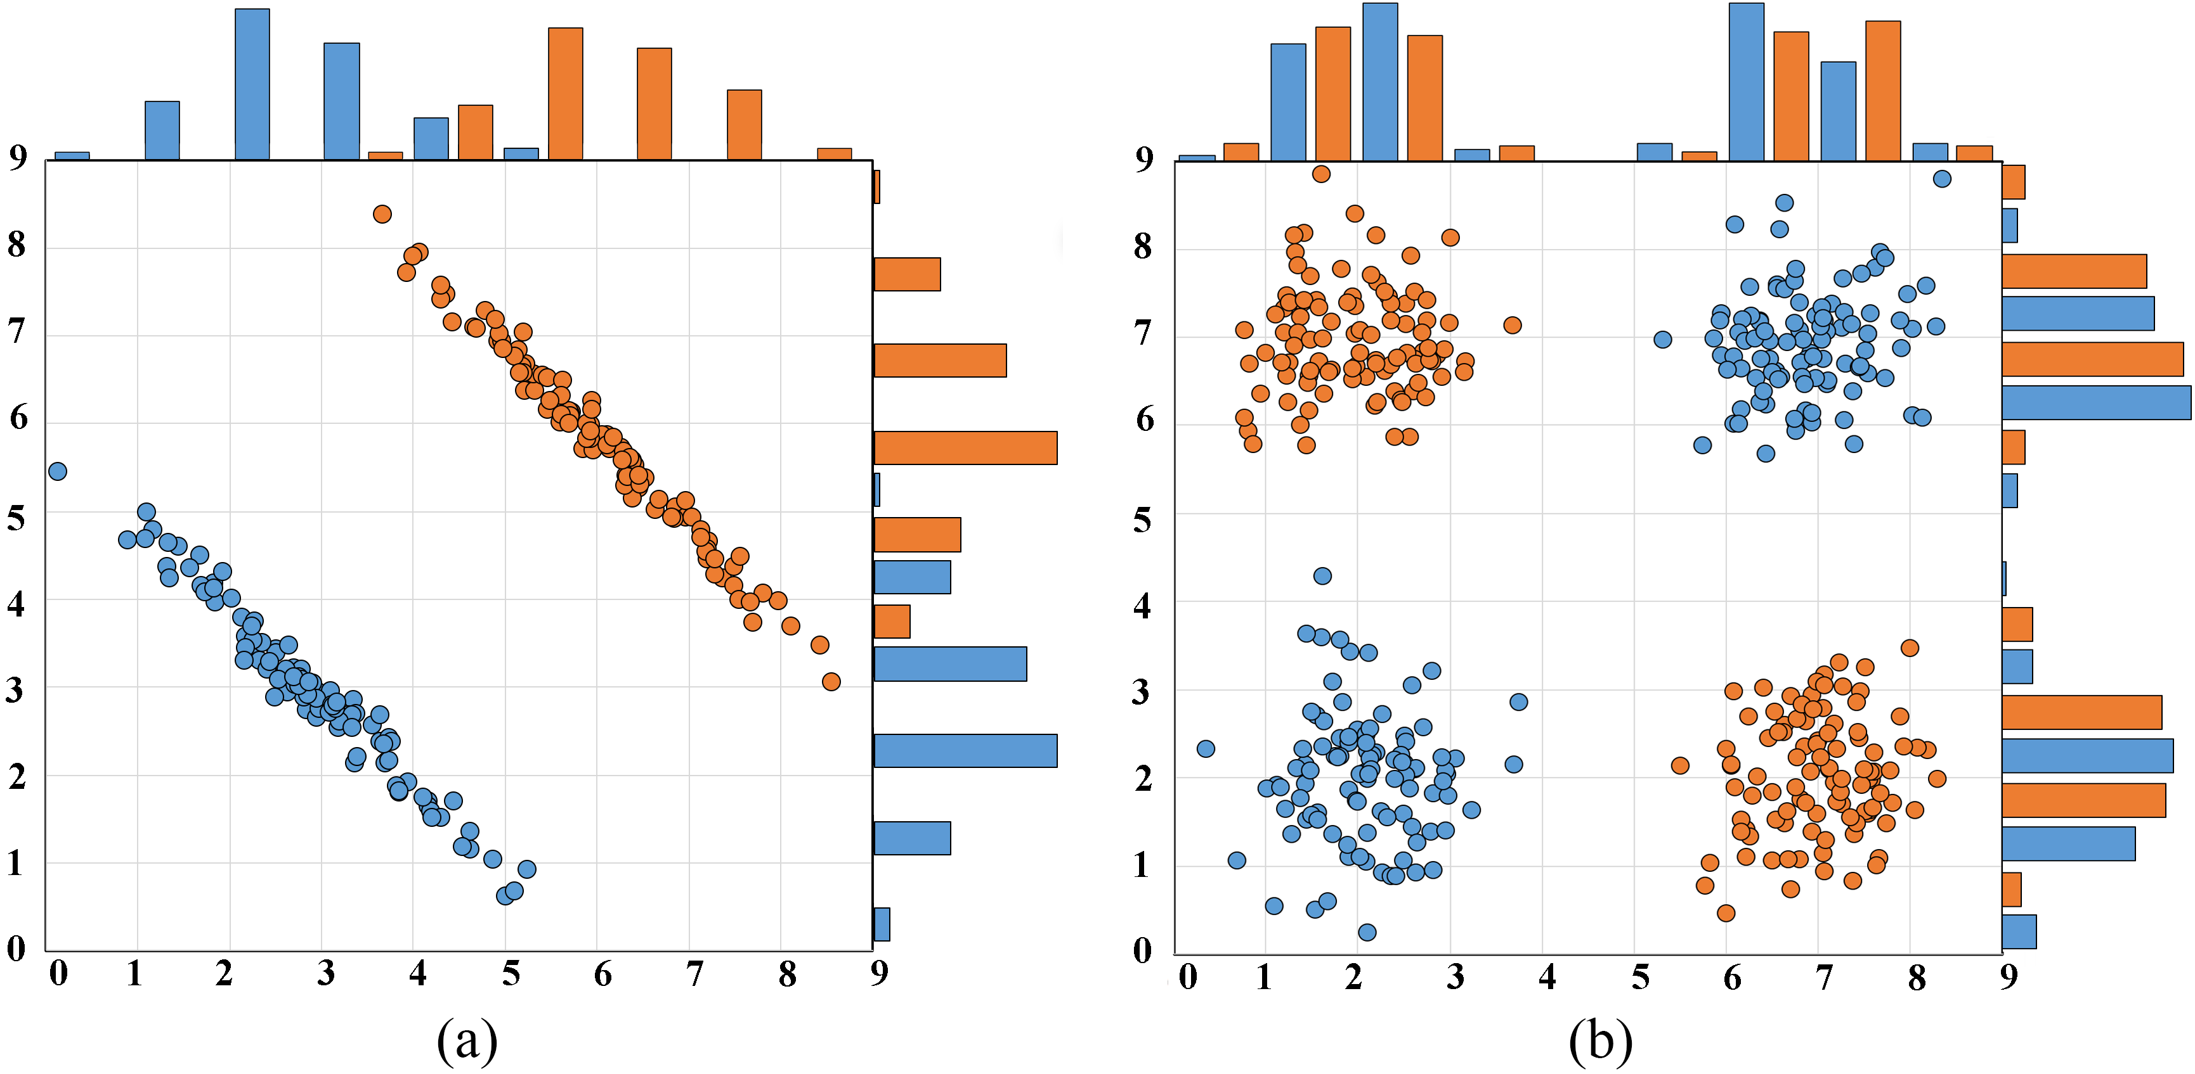
Overview: Why 2D, not 1D?

Slide 5
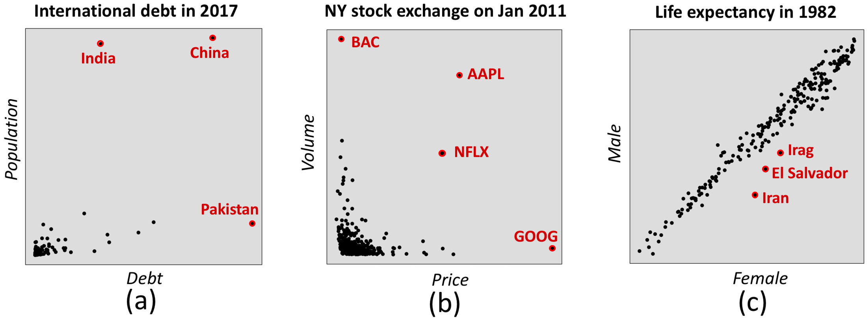
Overview: Why 2D, not 1D?

Slide 6
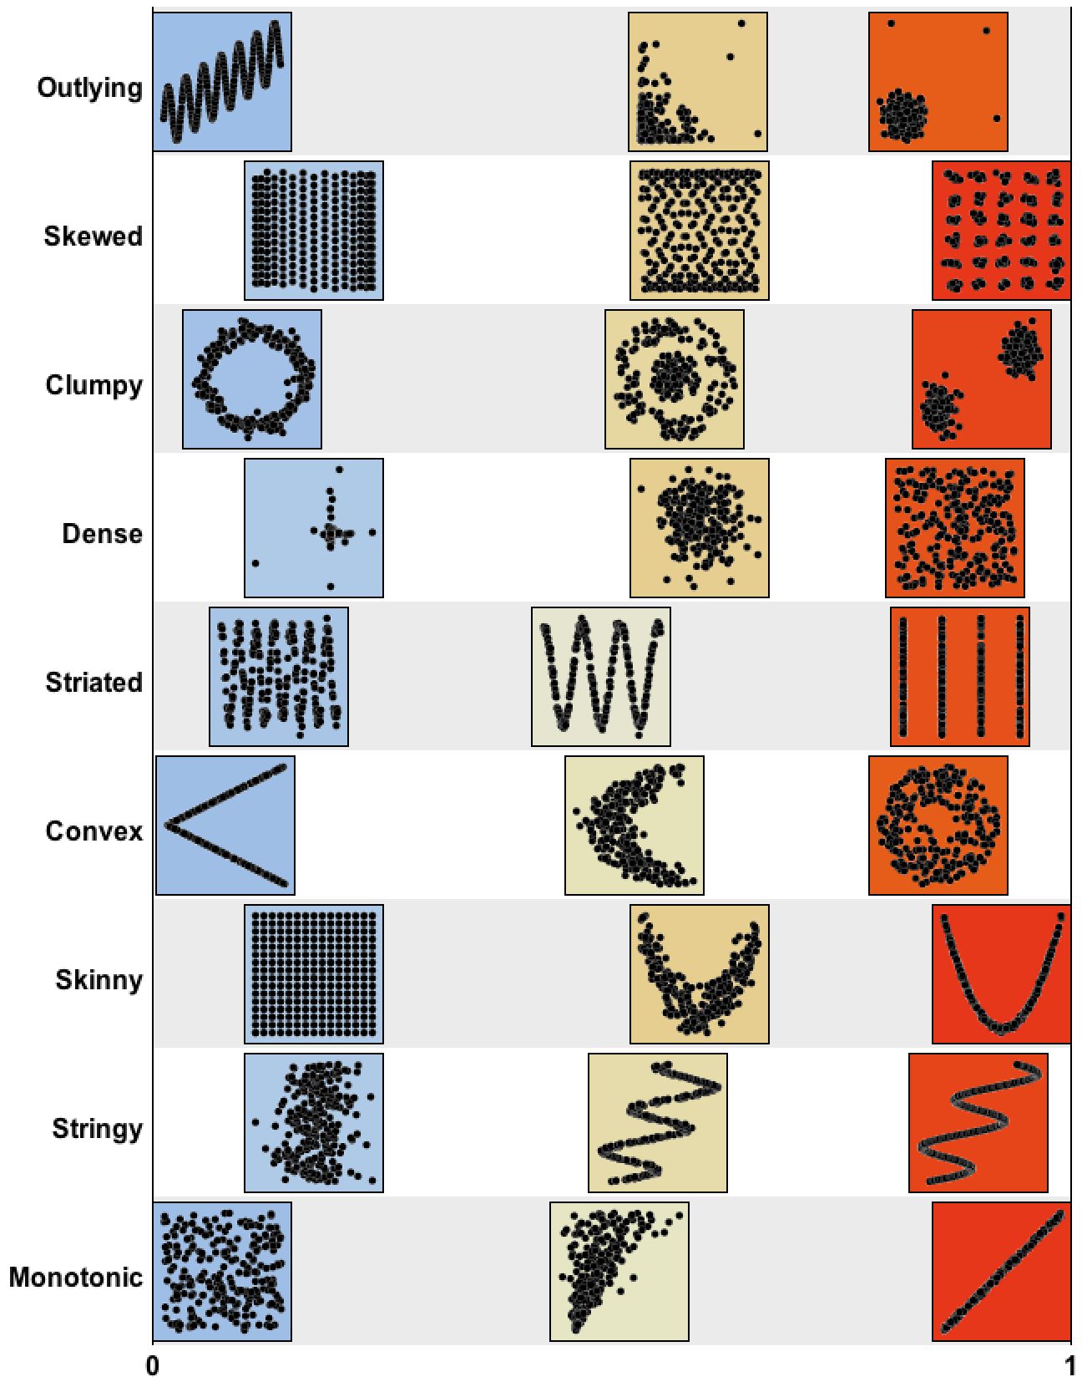
Background: 2D Visual features
Scagnostics (Scatterplot Diagnostics)
Scagnostics help us to characterize 2D scatterplots

Slide 7
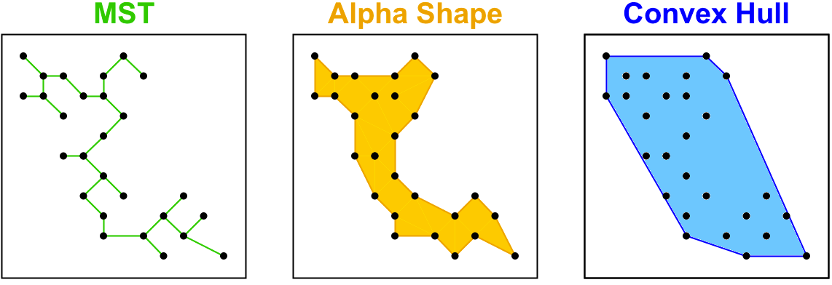
Three geometric graphs

Slide 8
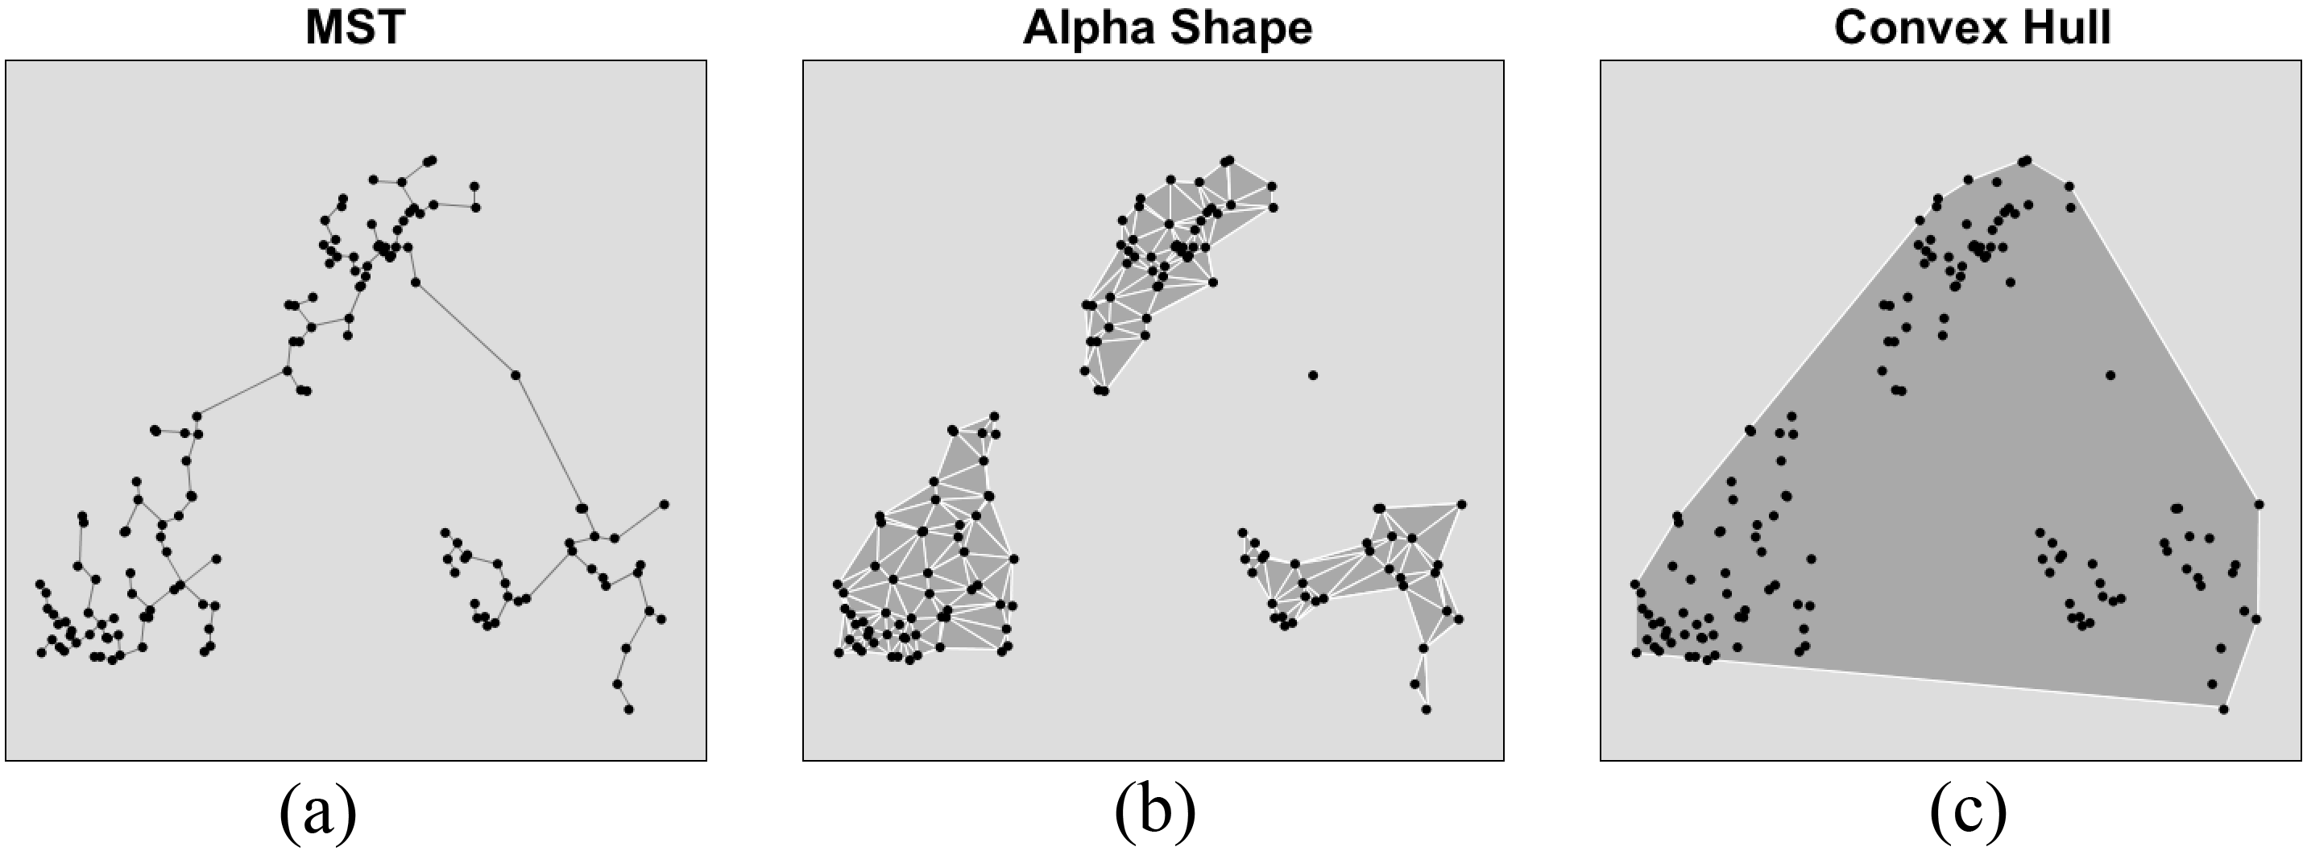
Three geometric graphs

Slide 9
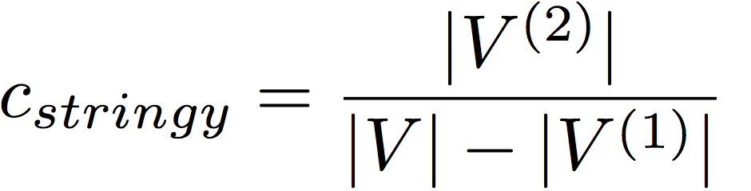
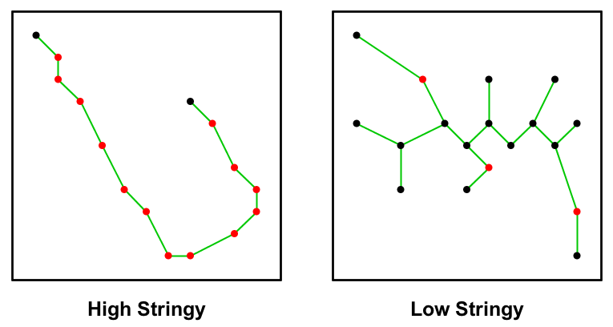
2D visual features: Stringy

Slide 10
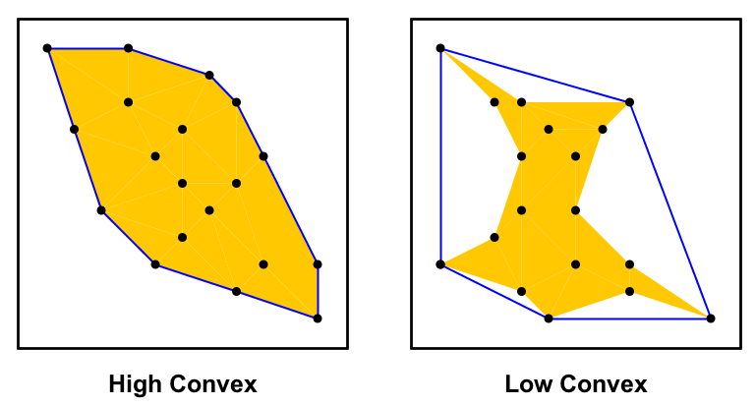
2D visual features: Convex

Slide 11
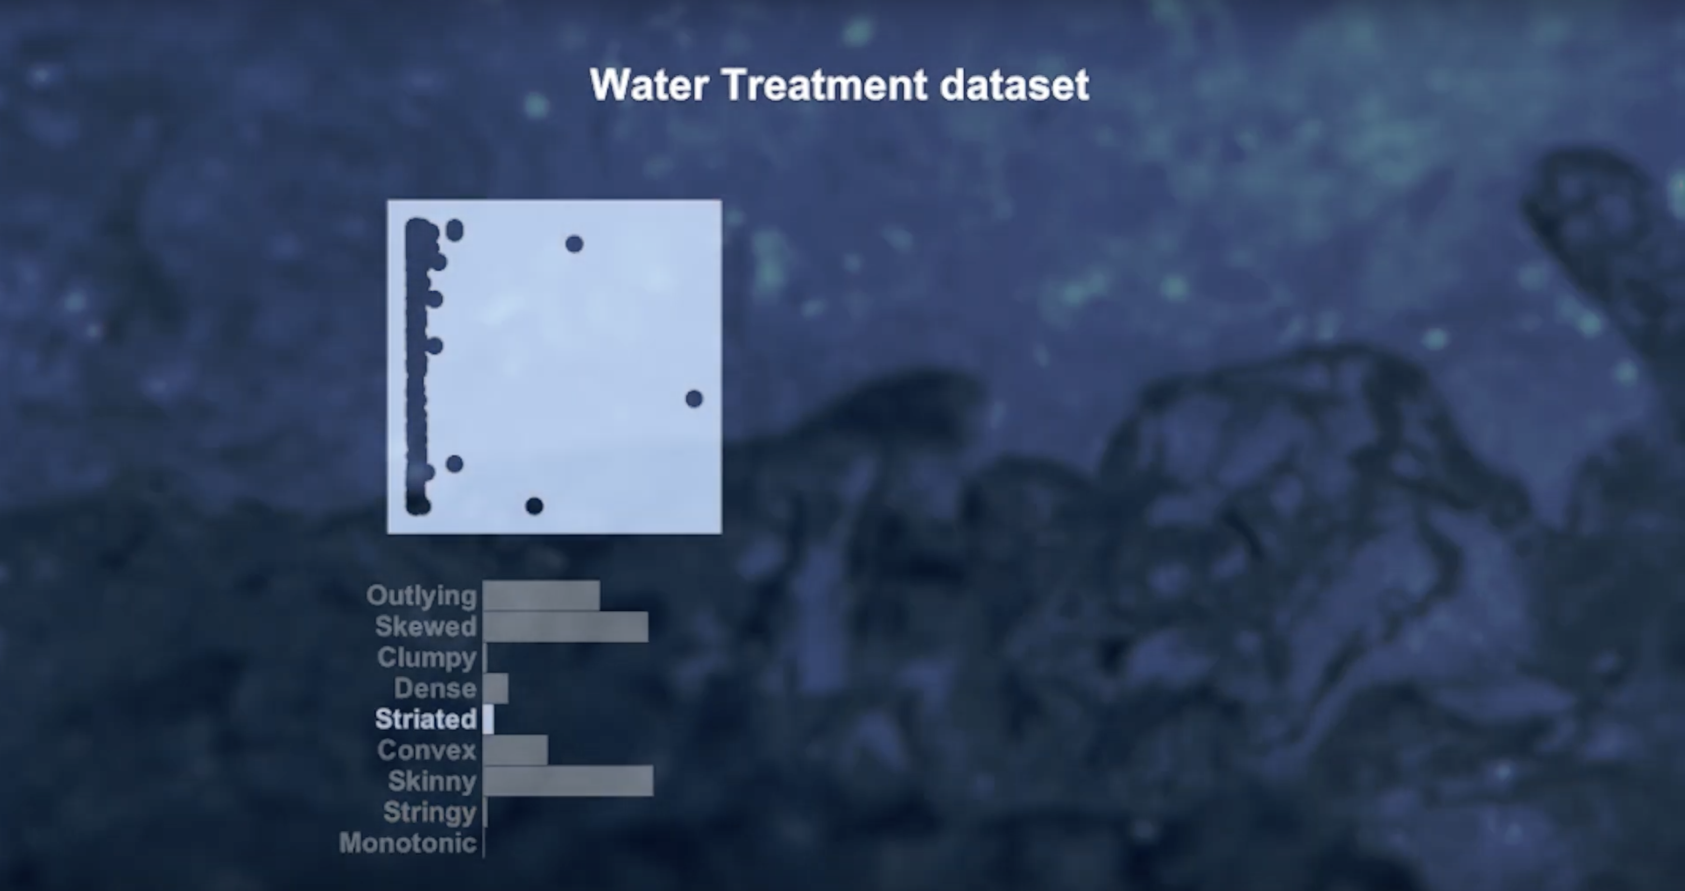
2D visual features
Every scatterplot is characterized by the 9 visual features

Slide 12
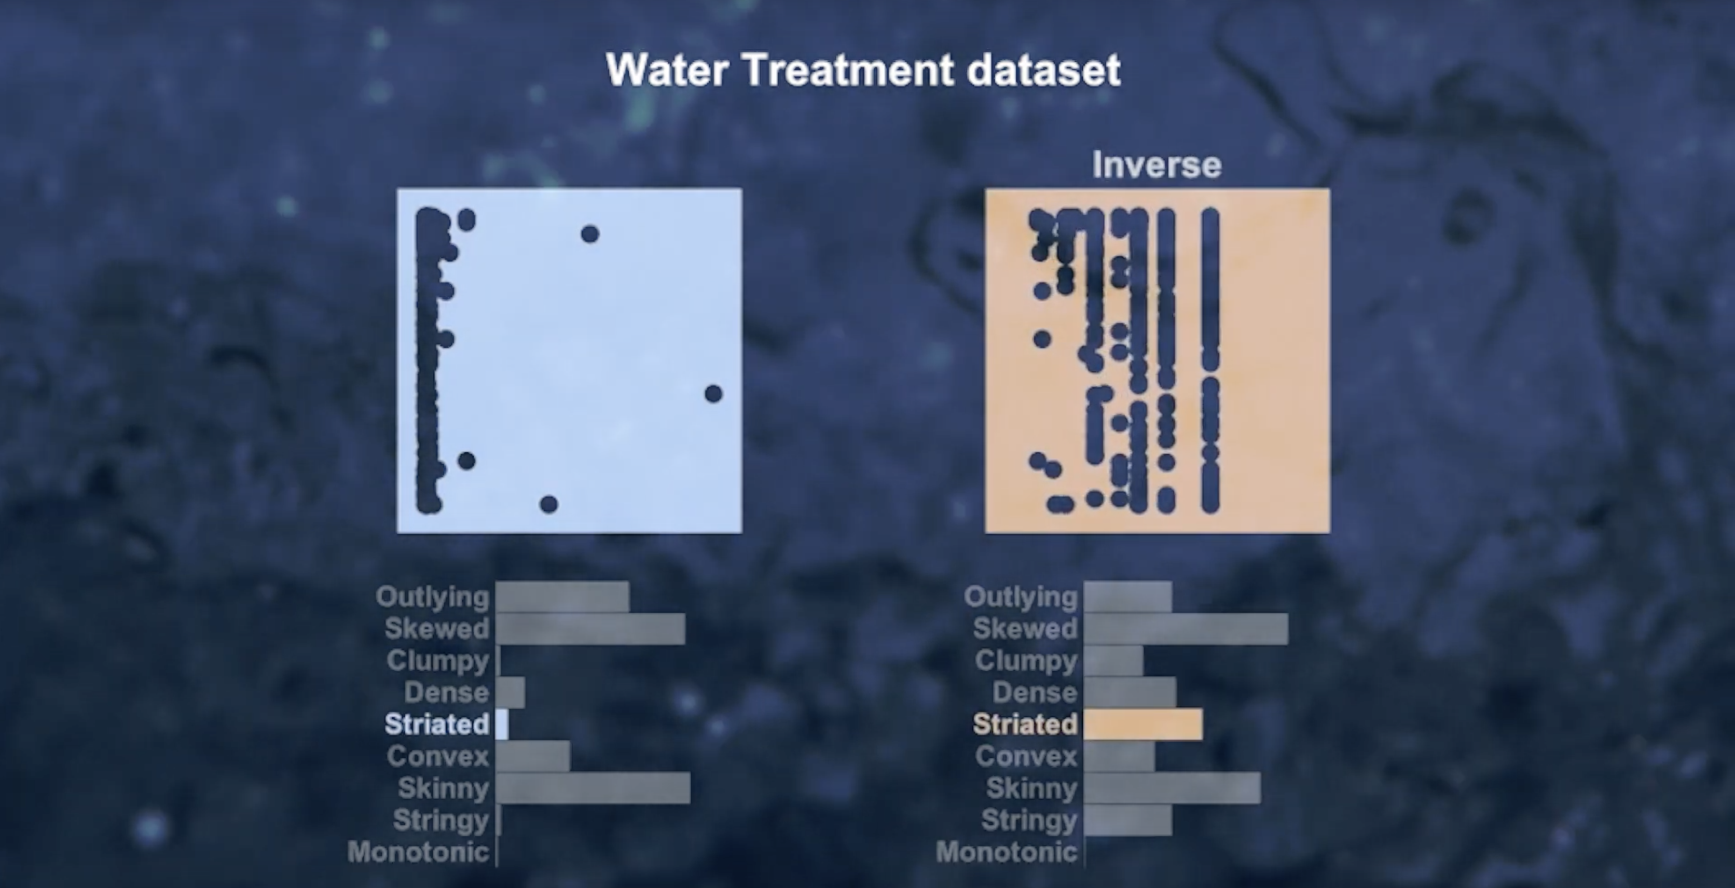
2D visual features
Two scatterplots are compared by their 9 visual features, not the data points
Scale for large datasets

Slide 13
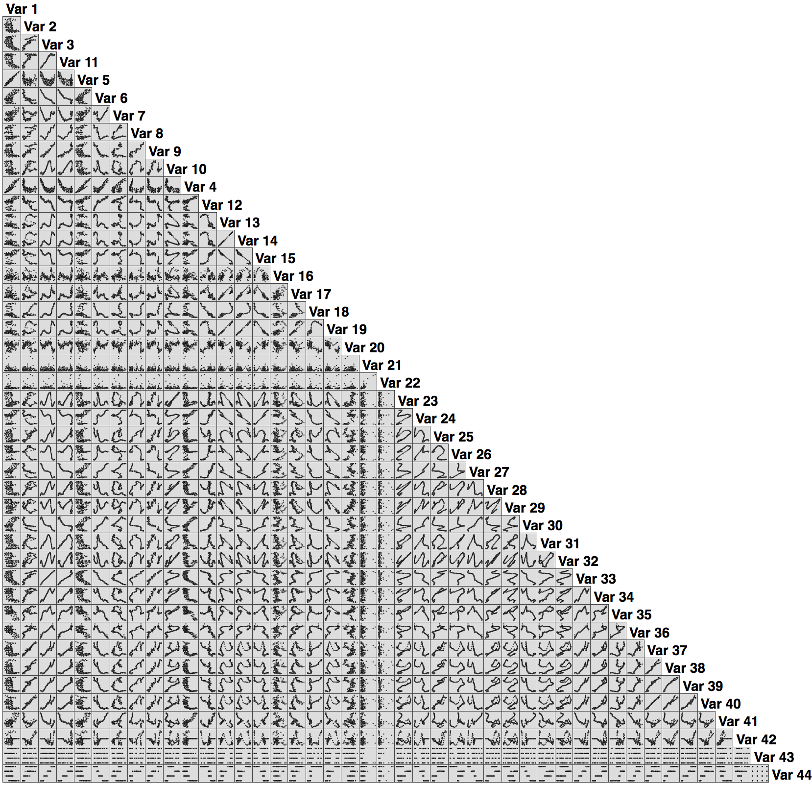
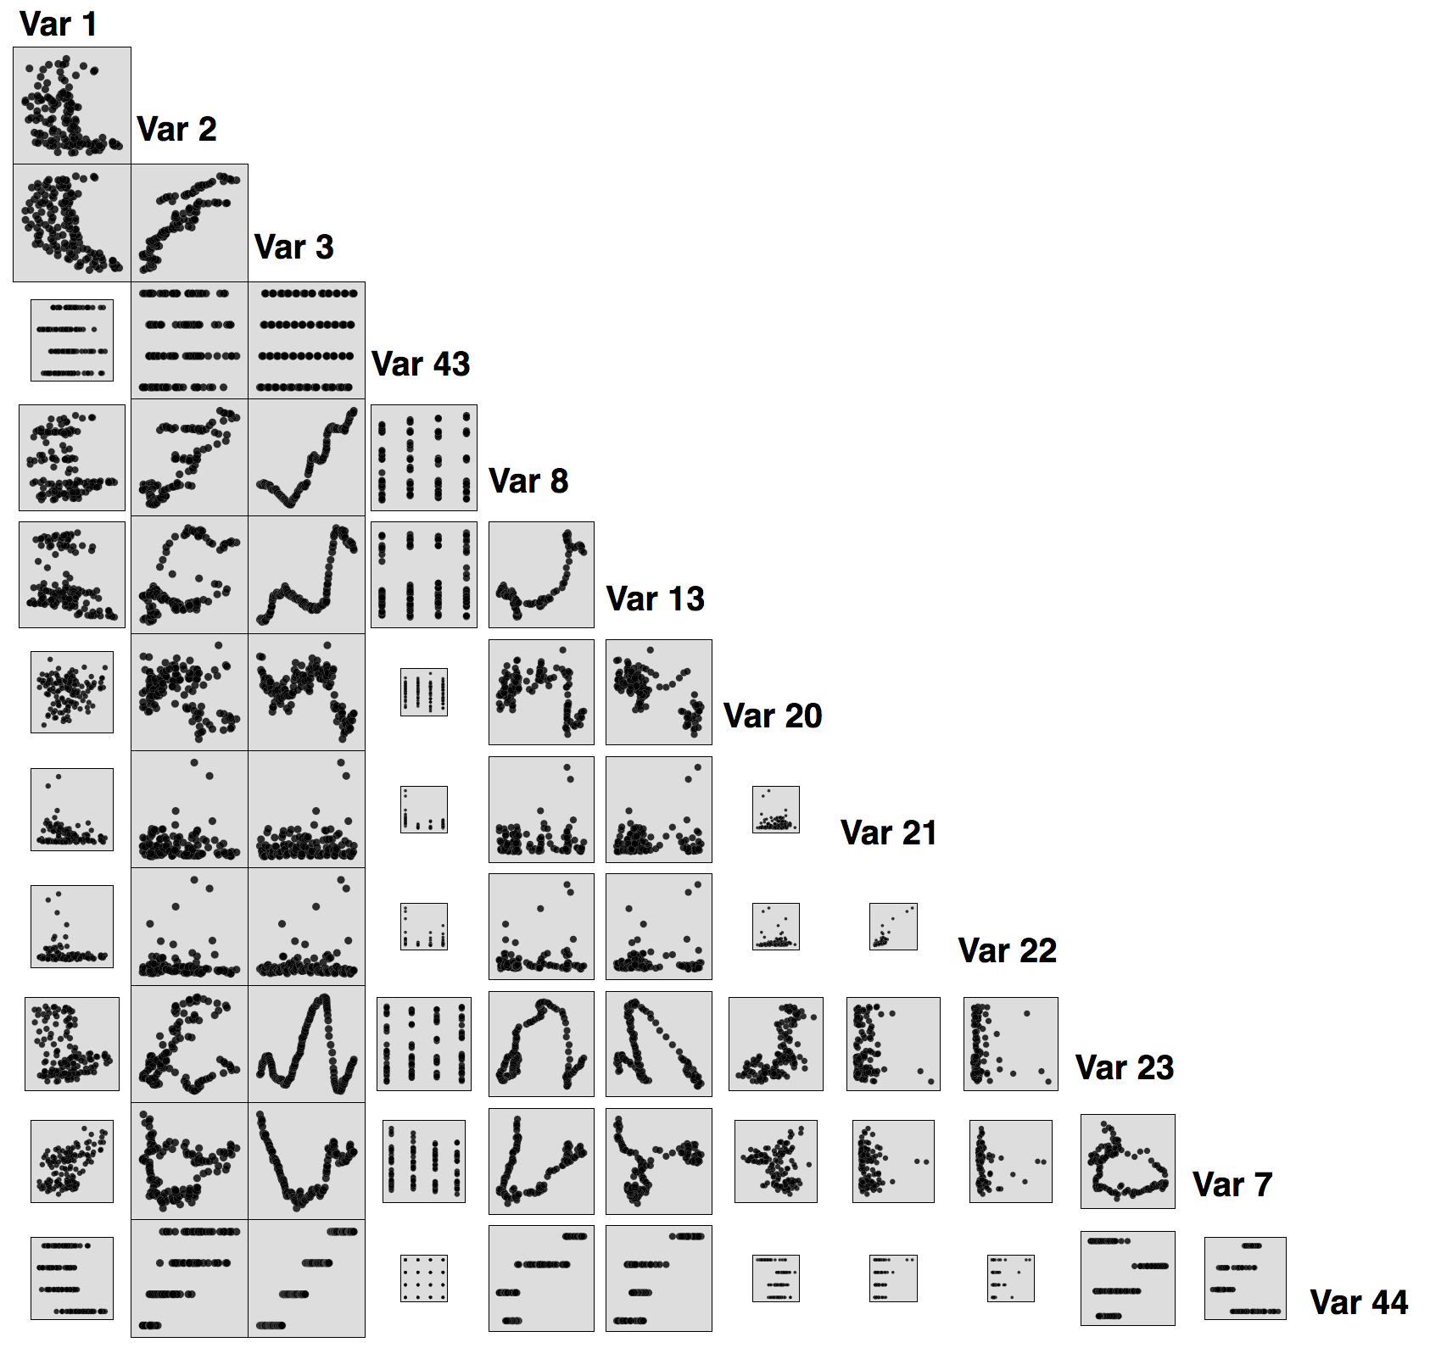
The Problem: Variable selection
Variable selection is one of the most fundamental research in multidimensional data analysis: The main idea is that the data contains many variables that are either redundant or irrelevant, and can thus be removed without incurring much loss of information

Slide 14
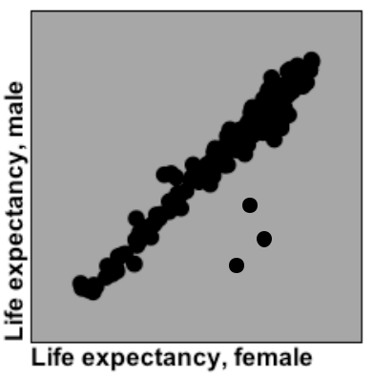
The Problem: Variable selection
Variable correlation (such as Pearson correlation) is the basic method of this class.
The Correlation Feature Selection: “Good feature subsets contain features highly correlated with the classification, yet uncorreated to each other”

Slide 15
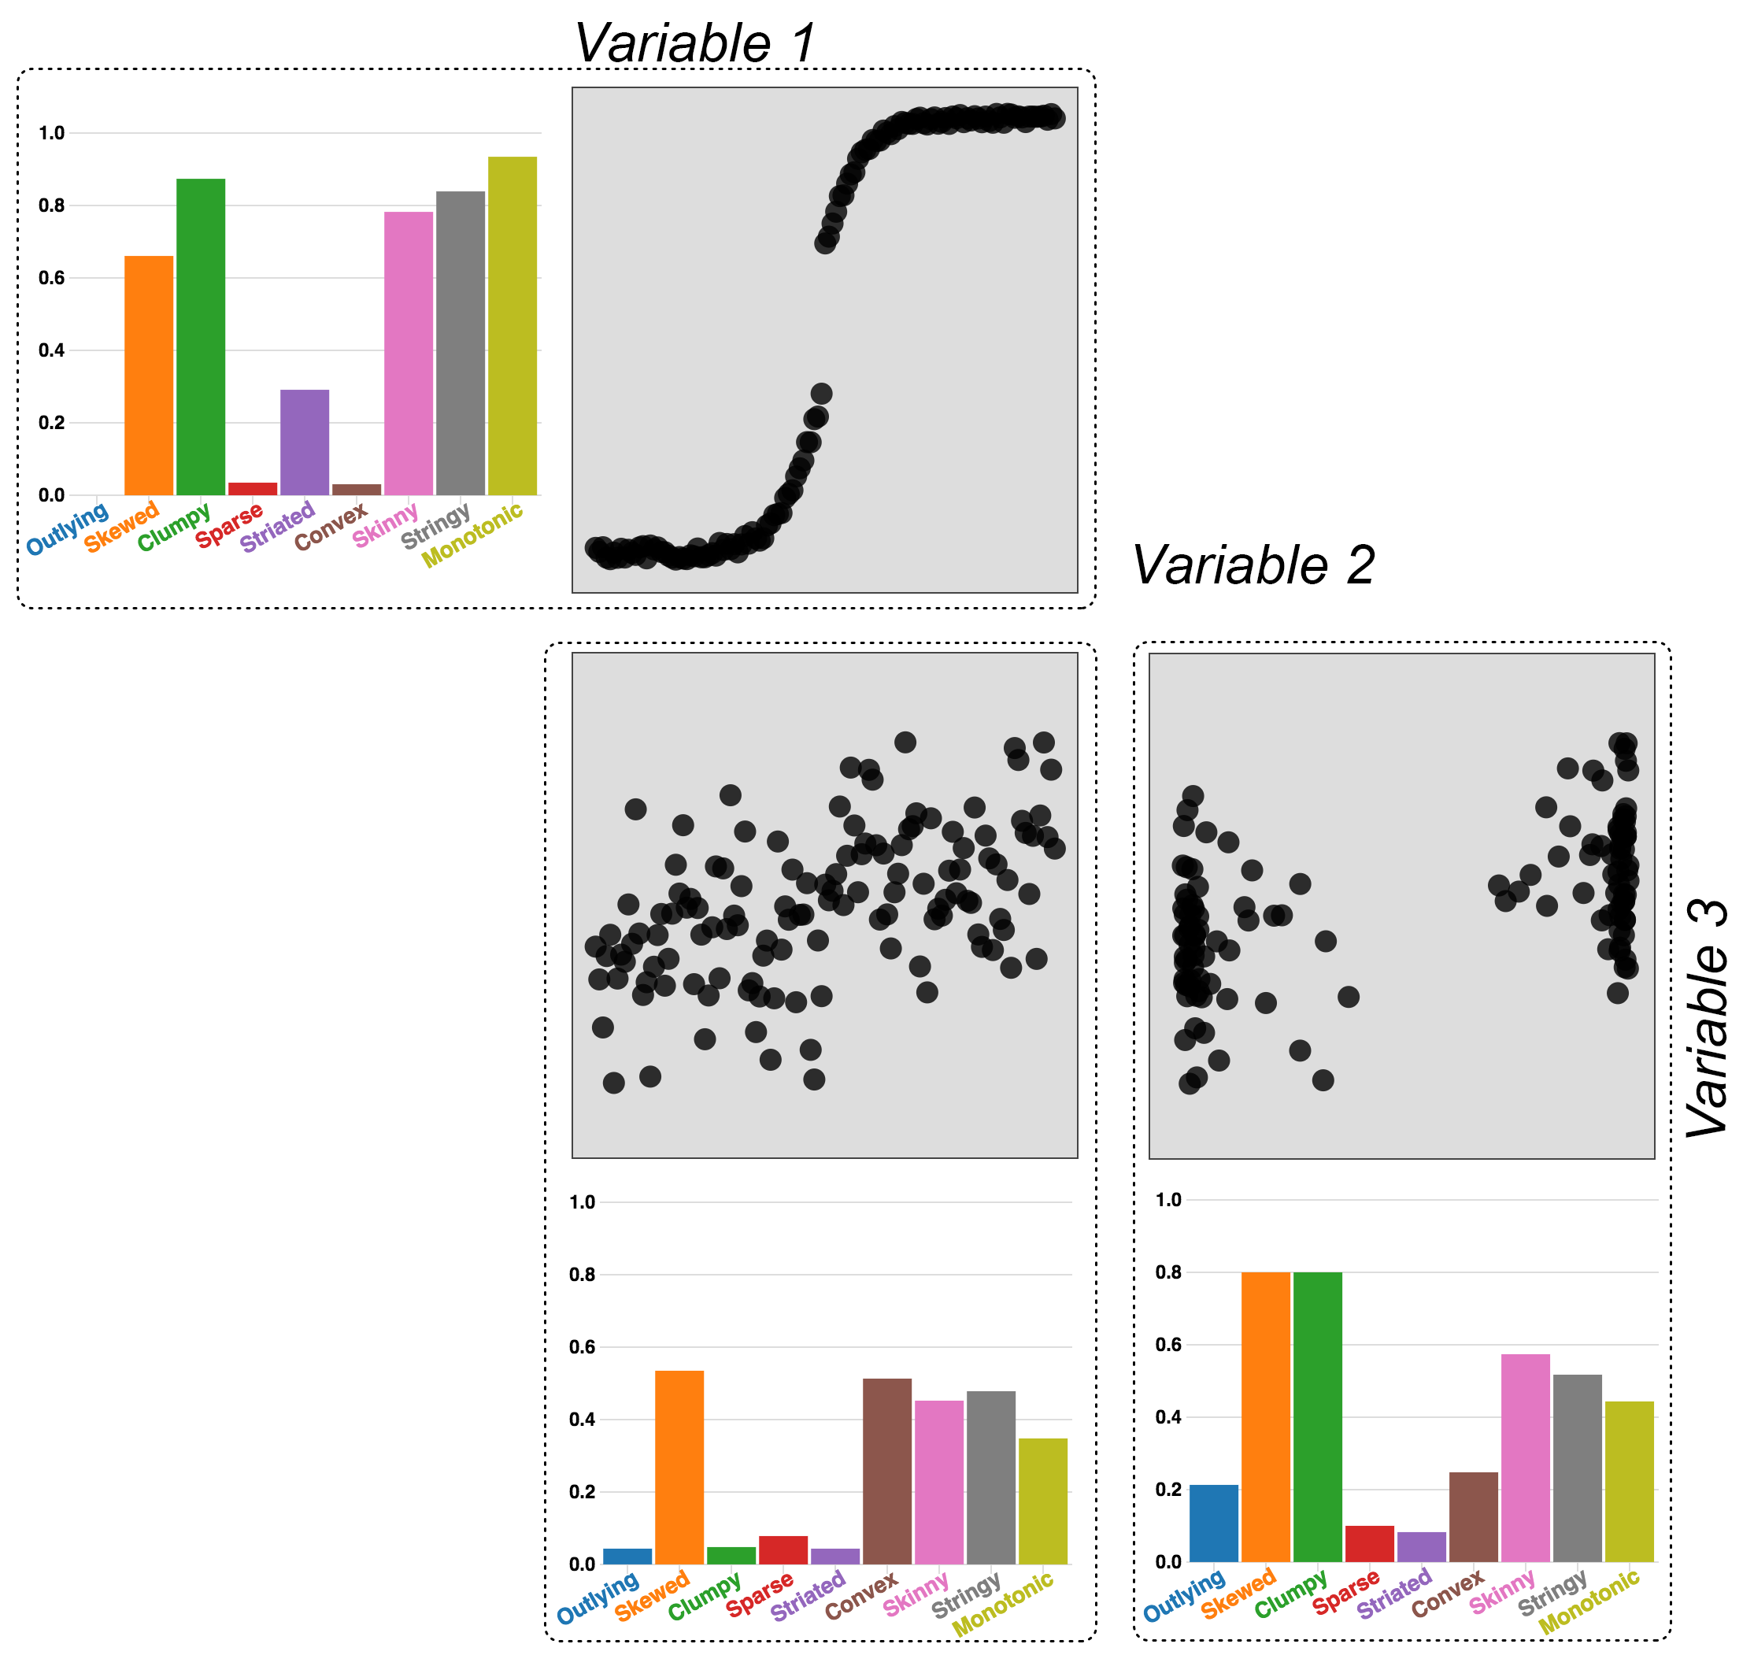
I argue otherwise: Example 1

Slide 16
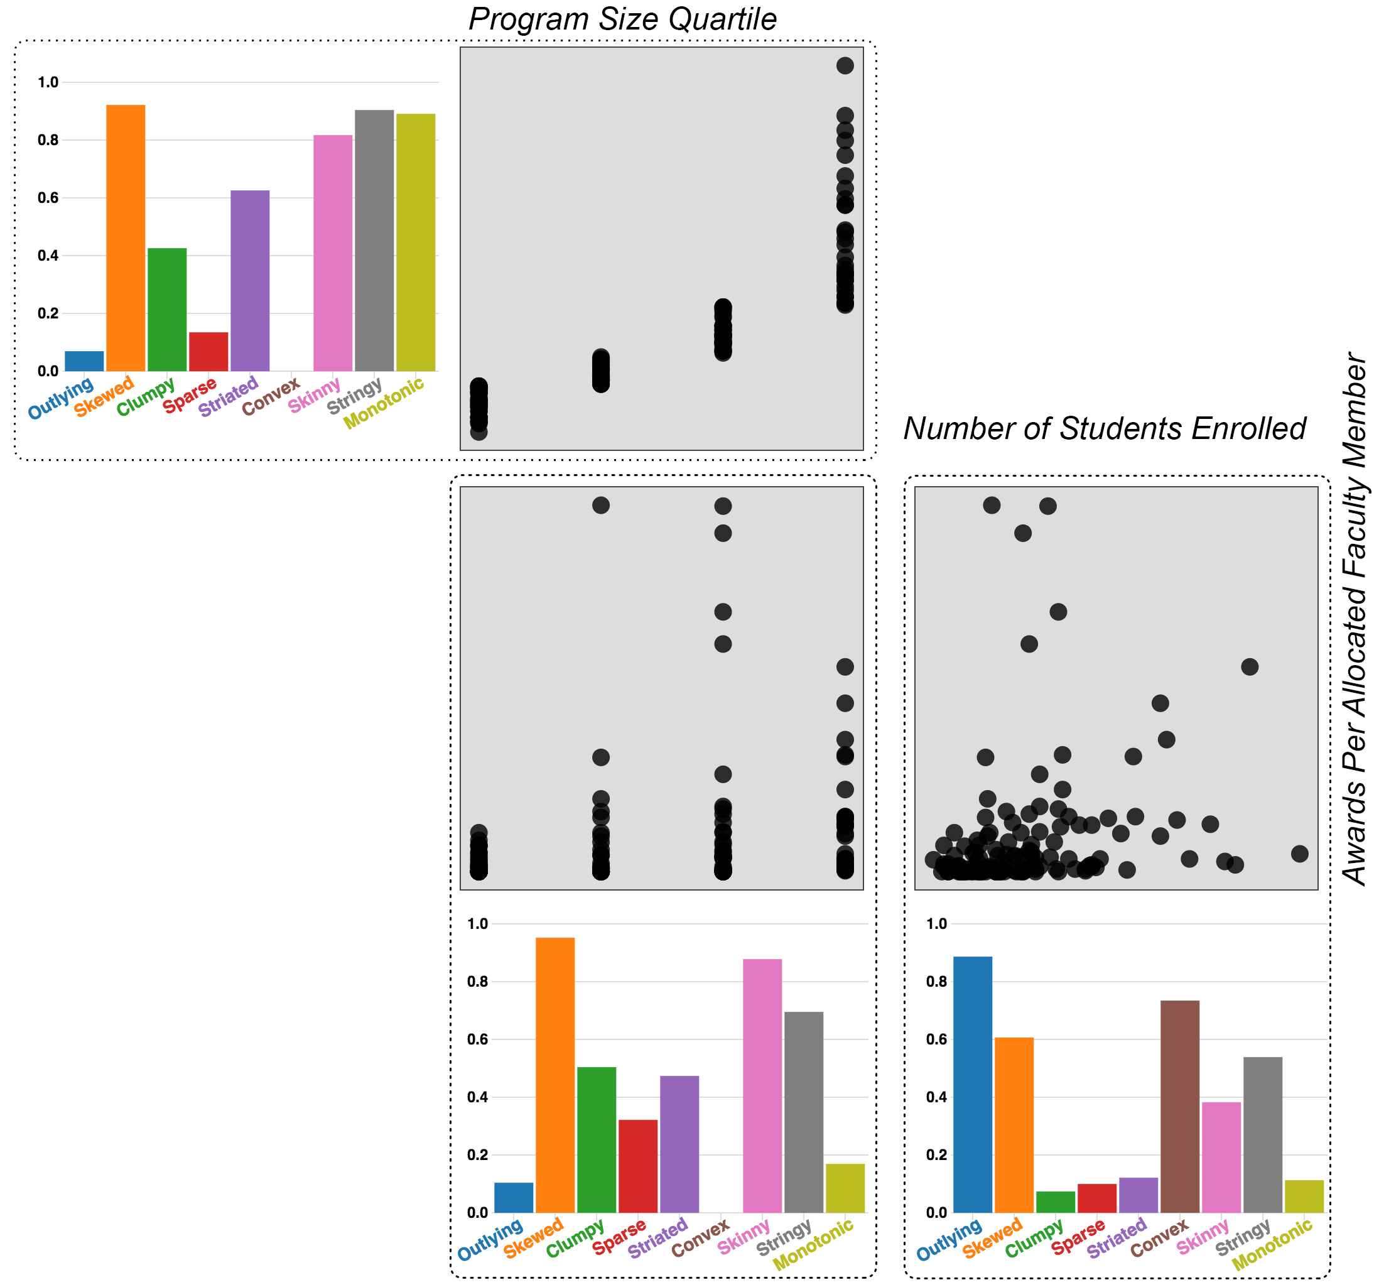
I argue otherwise: Example 2

Slide 17
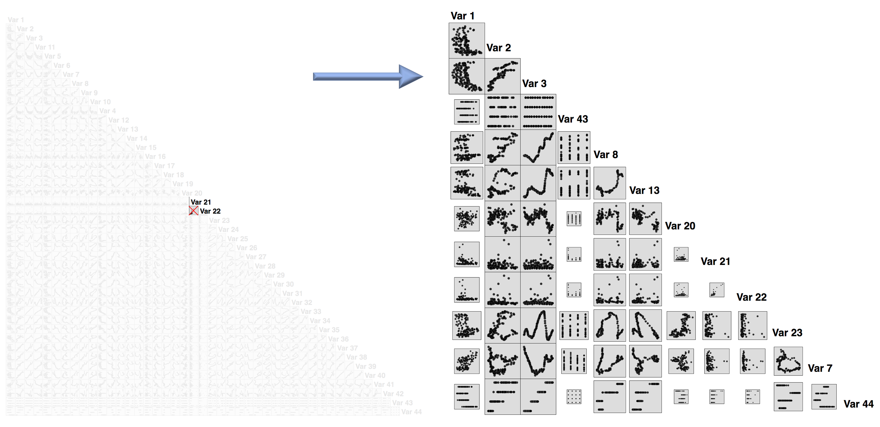

Slide 18
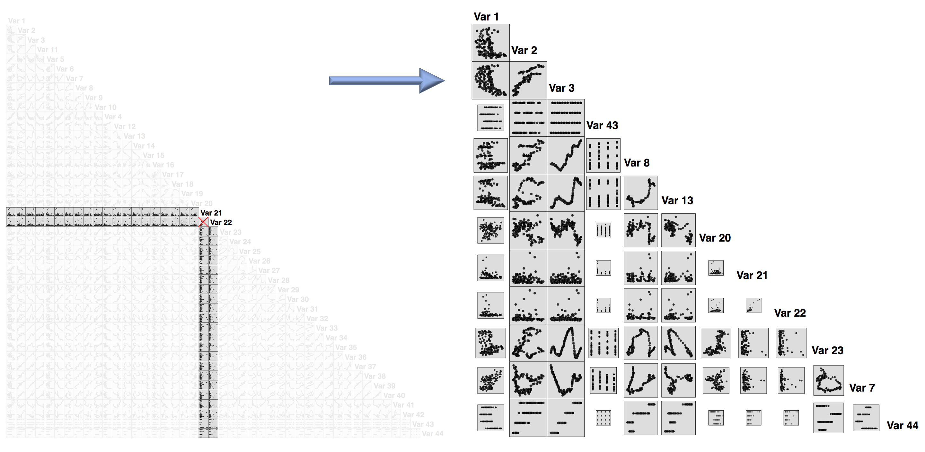

Slide 19
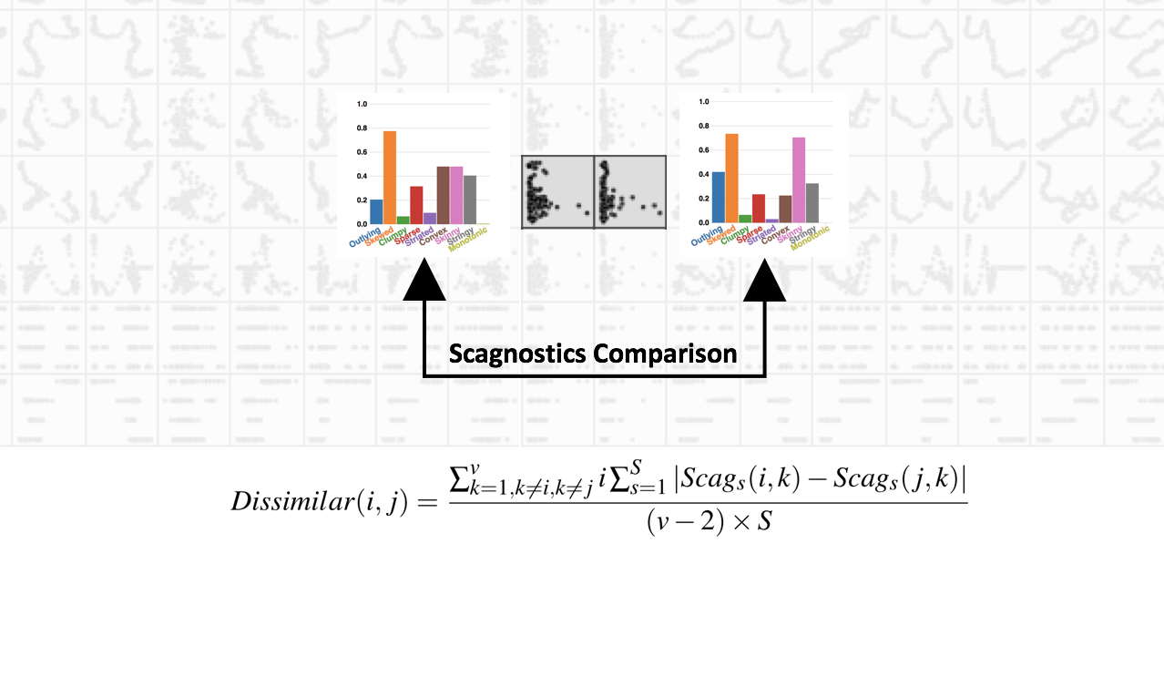

Slide 20
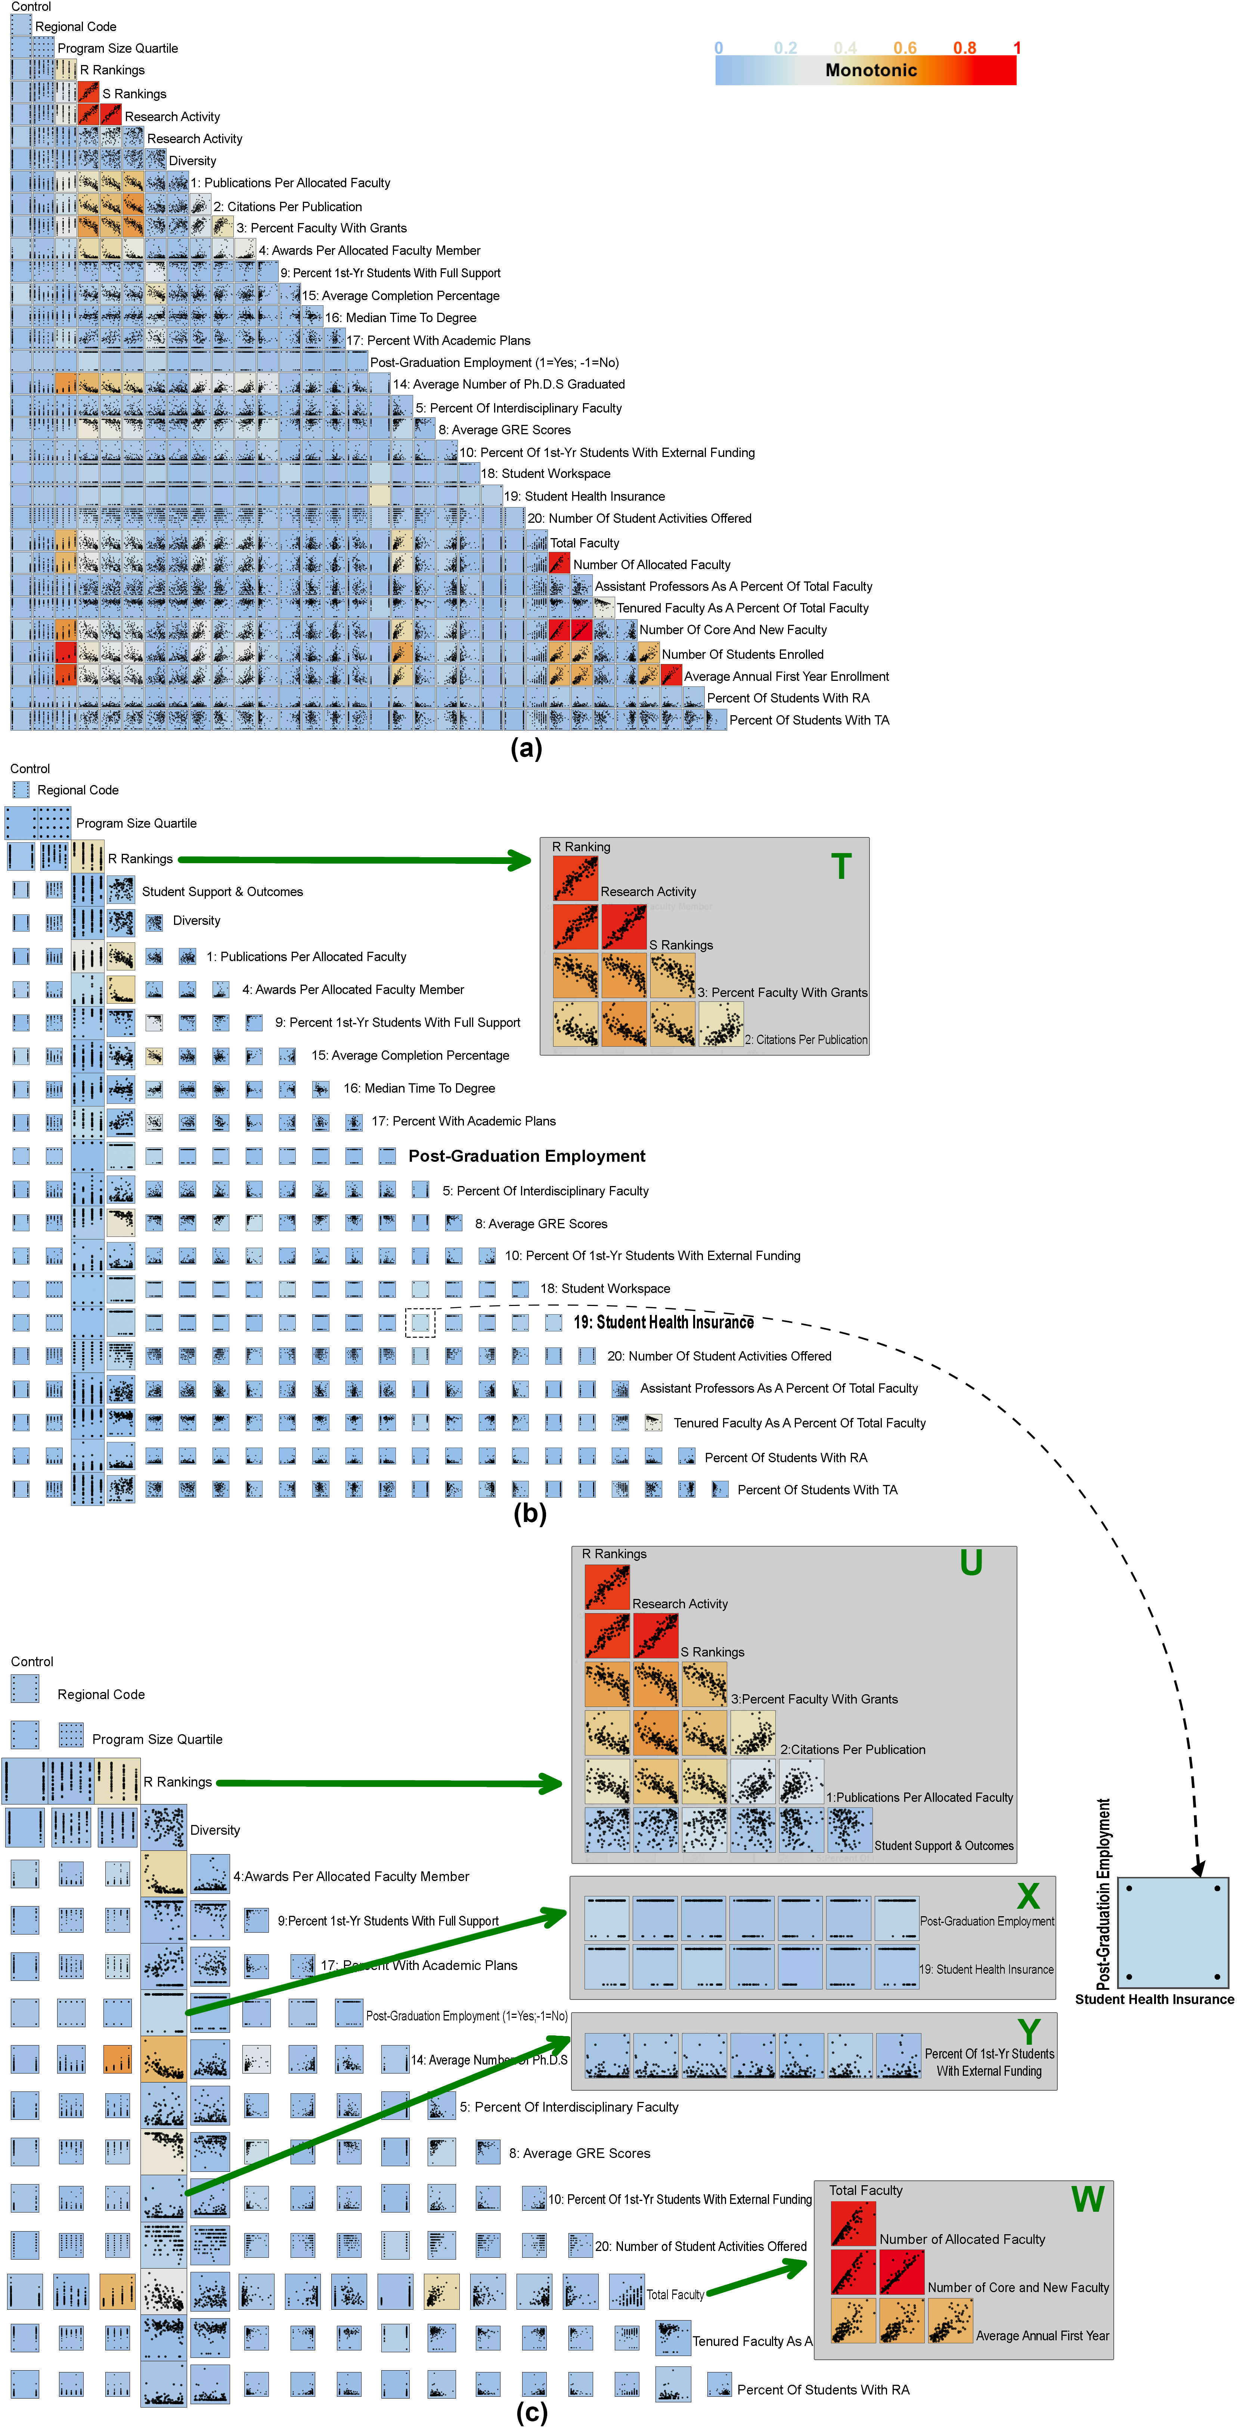
Fselector visualization
NRC university rankings in 2006

Slide 21
Fselector visualization

Slide 22
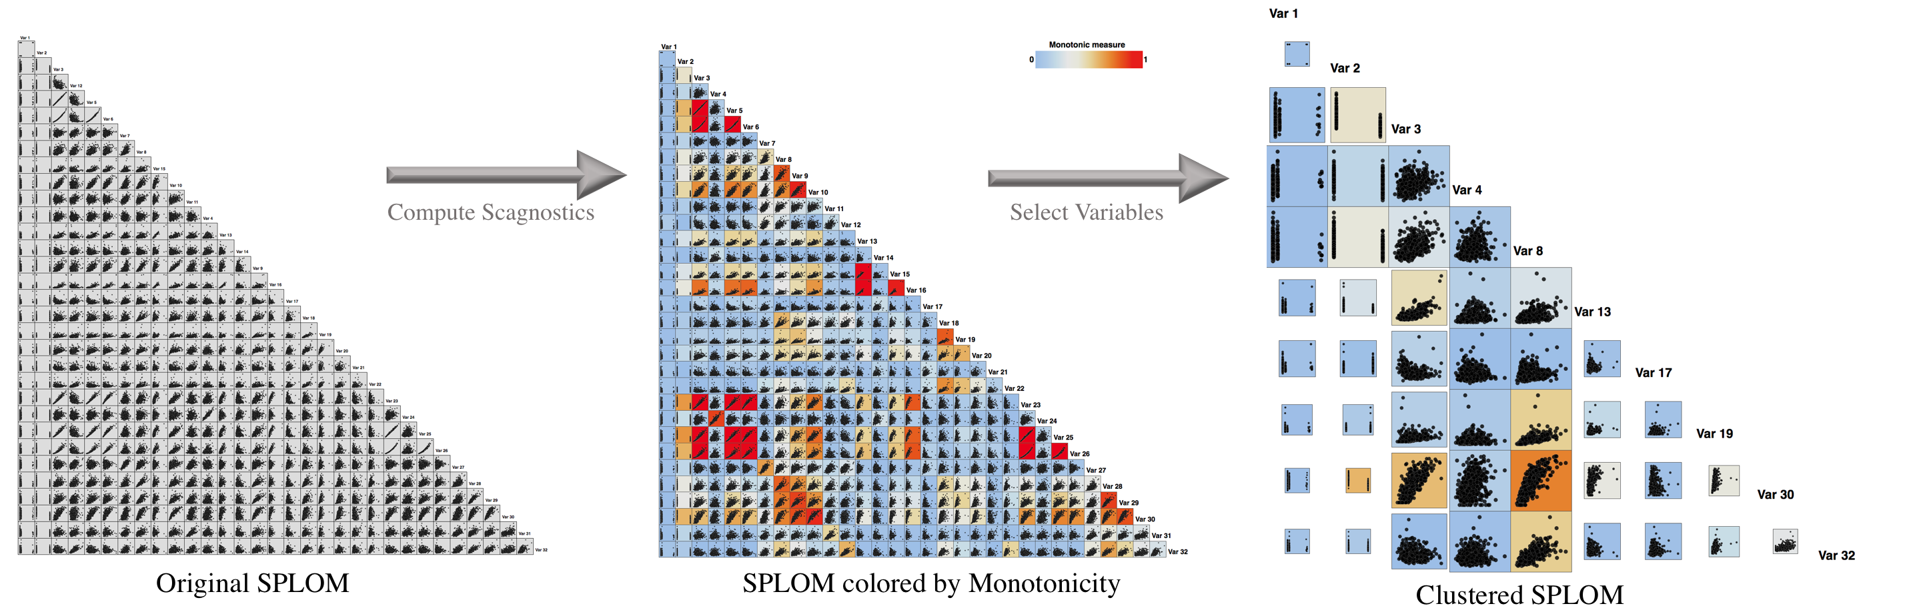
Fselector visualization
The Breast Cancer dataset

Slide 23
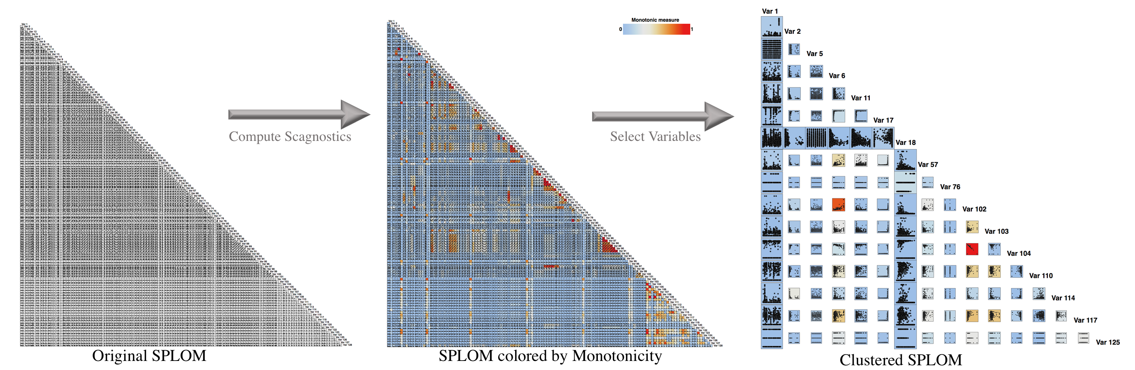
Fselector visualization
The Communities and Crime dataset

Slide 24
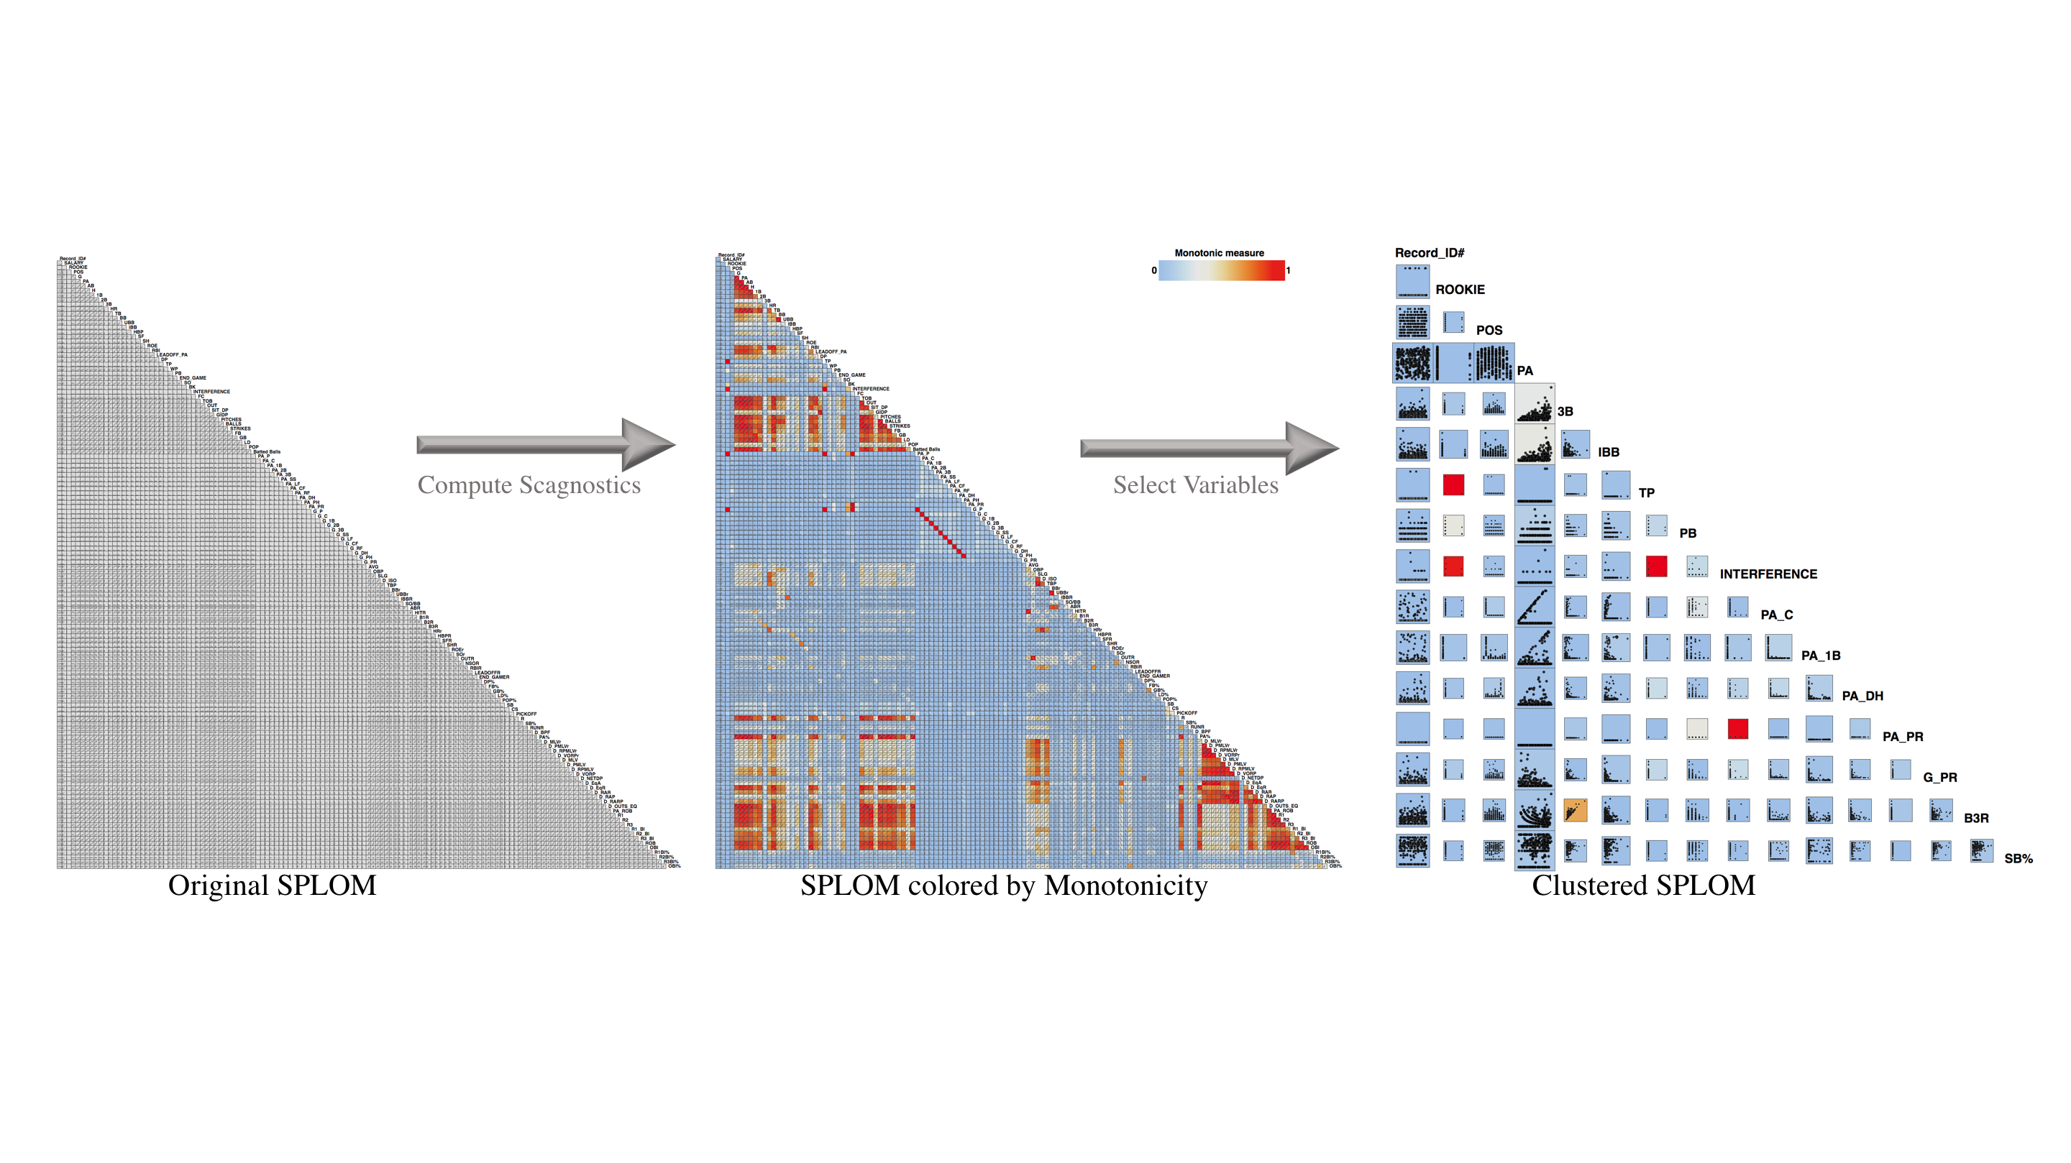
Fselector visualization
2008 MLB Team Statistics: https://www.baseball-reference.com/leagues/MLB/2008.shtml

Slide 25
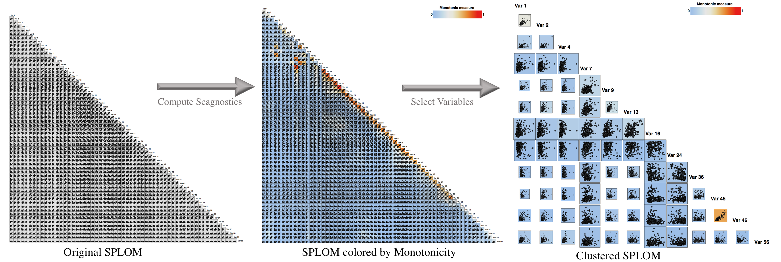
Fselector visualization
The Sonar dataset

Slide 26
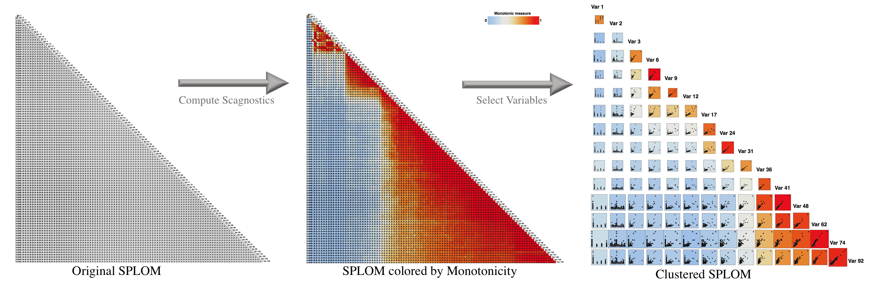
Fselector visualization
The NYC Subway Ridership dataset

Slide 27
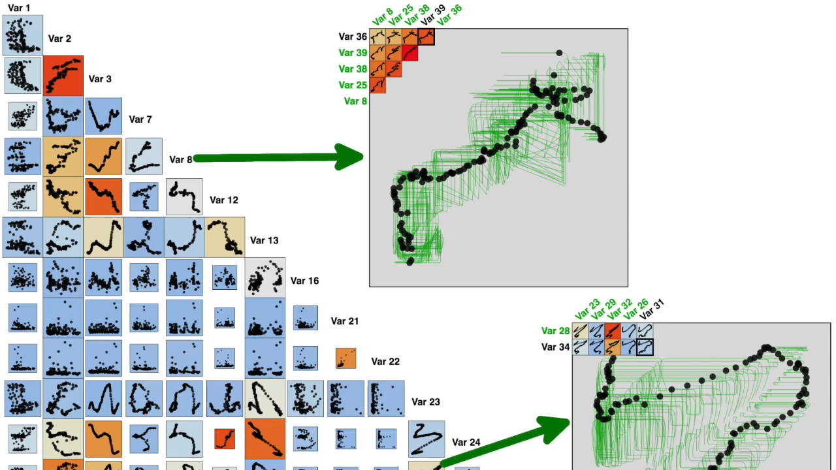
Demo: start at 2:10
https://featureselector.github.io/demos.html

Slide 28
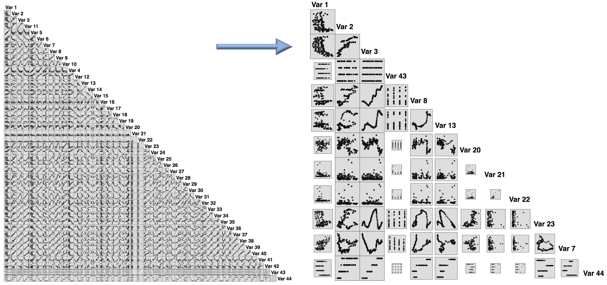
Summary

Slide 29
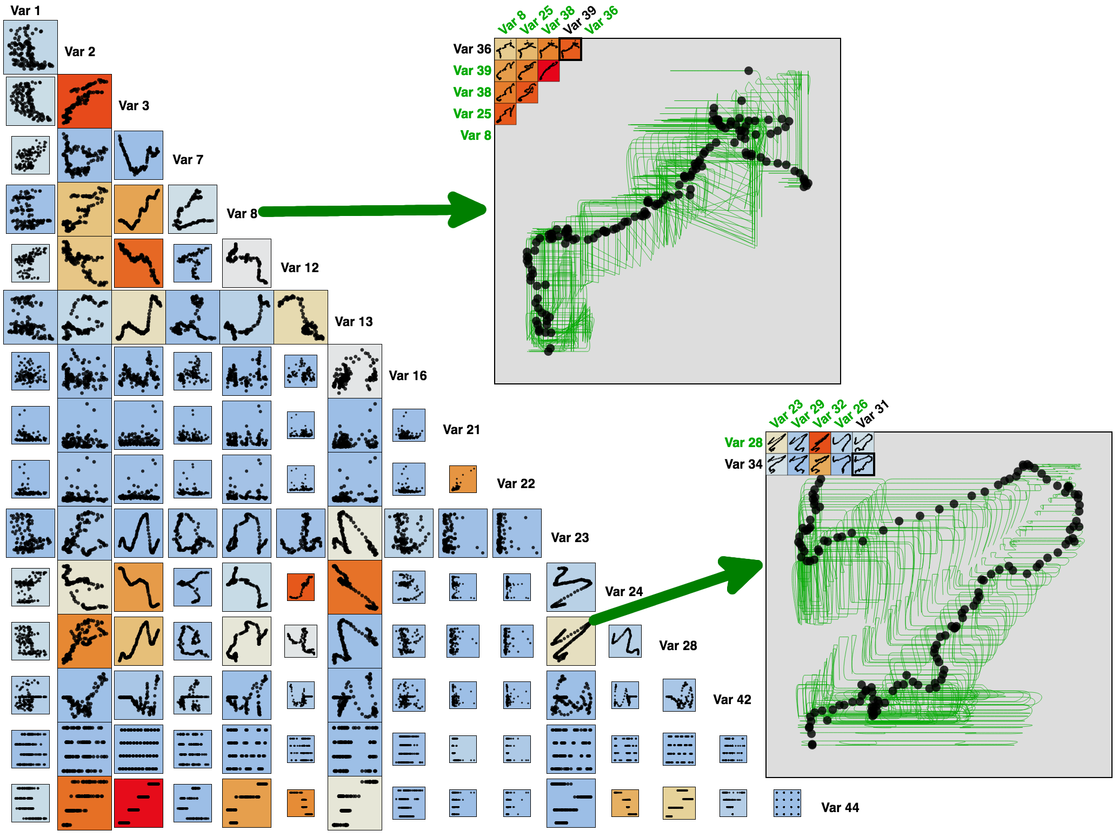

Questions?
Email: Tommy.Dang@ttu.edu

